Slide 1
Twitter Data Project
Application in Data Frame and Hadoop
Wanting Tan

Slide 2
Contents
Topic Introduction
Challenges
Topic 1 in Data Frame
Topic 2 in Hadoop and Data Frame
Project Summary

Slide 3
Topic Introduction
Topic Name | Key Words | Time | File Size | Number of Tweets | Reason for Choosing
Skin care | skin care anti aging skincare routine | Total: 39h Dec.3 1h Dec.4 10h Dec.5 18.5h Dec.7 9.5h | 74.3 MB | 14044 | I’m thinking of changing my skincare brand
Trade War | china trade china trump trade war | Total: 29.5h Dec.3 1h Dec.4 10h Dec.5 12h Dec.7 6.5h | 310 MB | 35758 | Dec.2 The US and China agreed to a temporary truce to de-escalate trade tensions

Slide 4
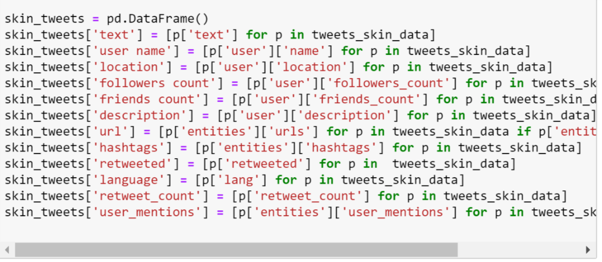
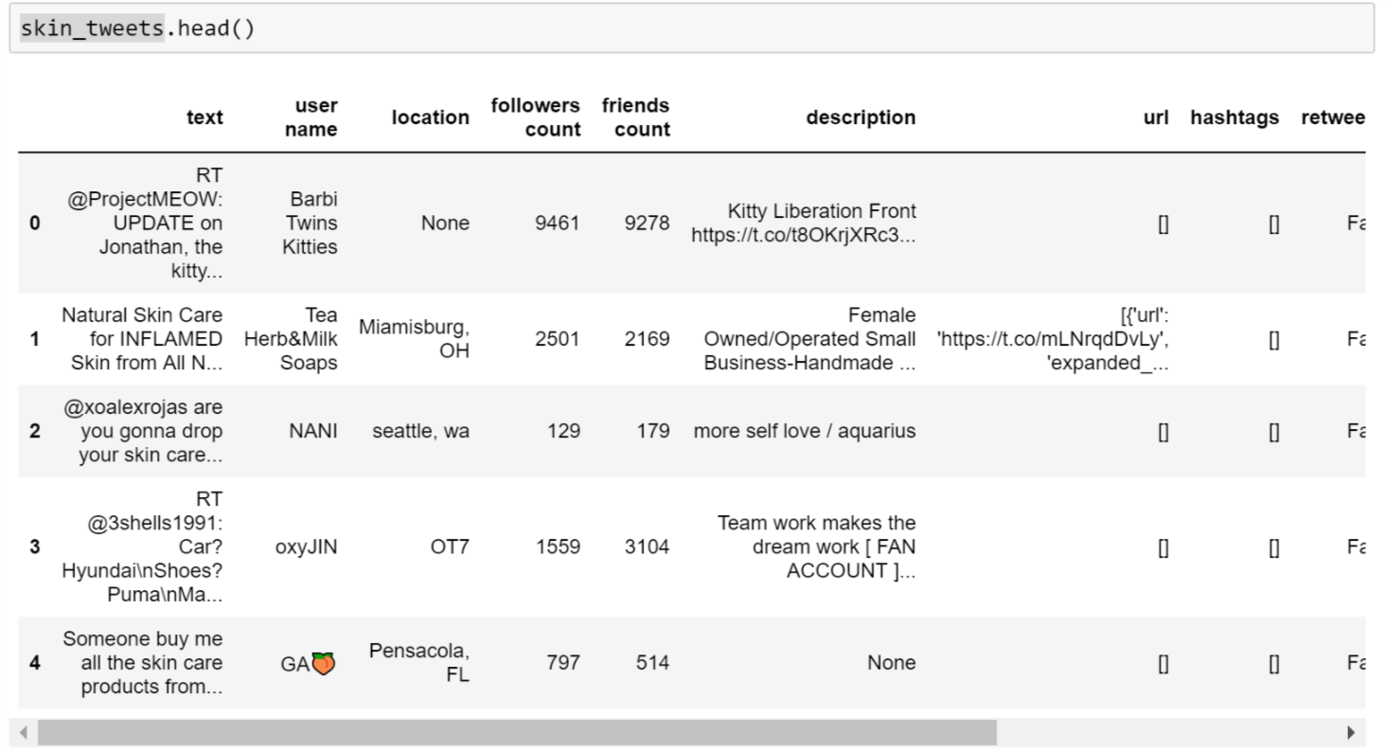
Challenges
Topic 1: Skin Care
Transform from JSON to Data Frame
hard to clean eg: link, @ 💦 🌸 😂
Topic 2: Trade War
Large dataset that is too slow to use data frame
Hard to write map function for top significant words (can’t use packages like NLTK, stopwords )

Slide 5
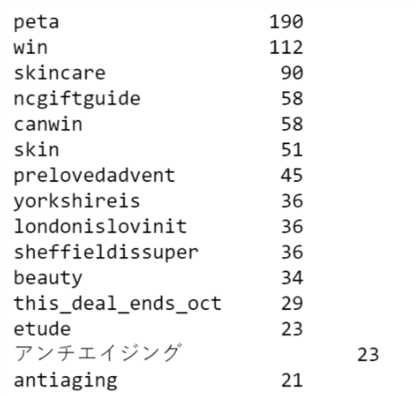

Topic 1: Skin Care
Top hashtags
Most tweets don’t have hashtags
Peta and win are two most popular hashtags

Slide 6
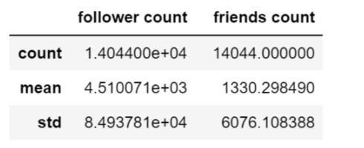
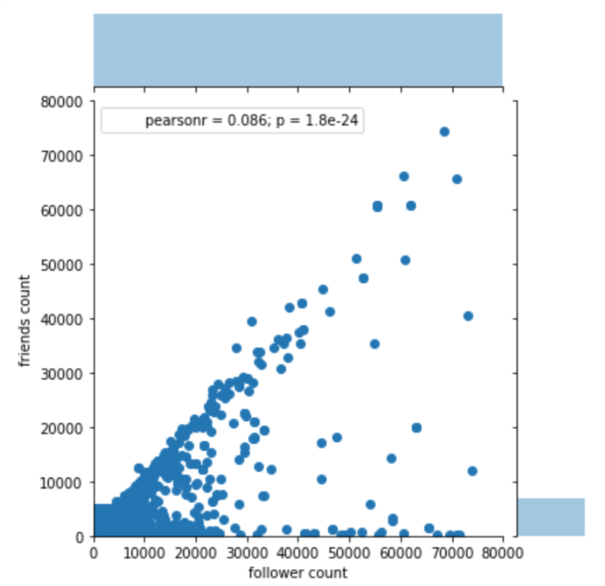
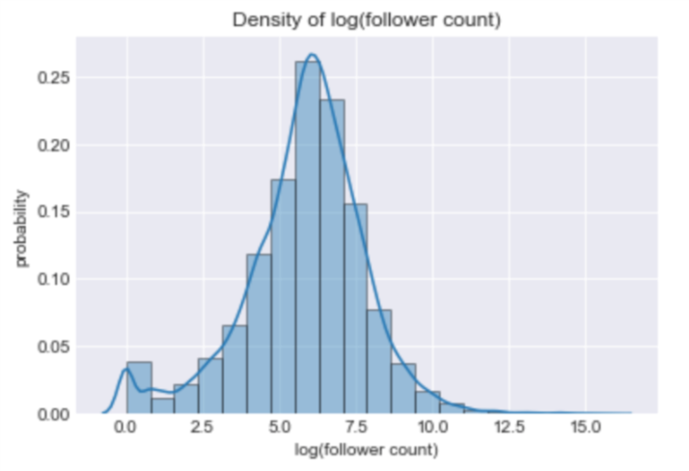
Topic 1: Skin Care
Follower count vs friends count
Correlation between followers count and friends count
Density plot of log(follower count)

Slide 7
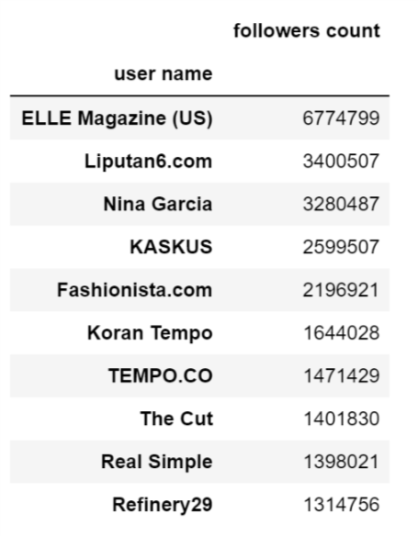
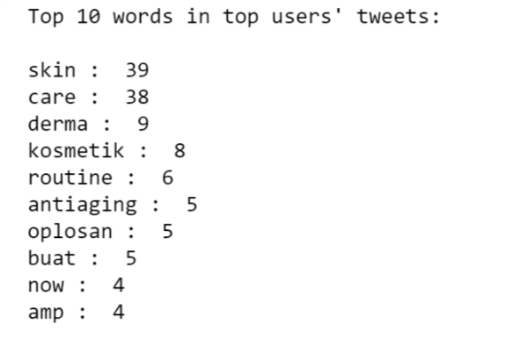
Topic 1: Skin Care
Top authoritative users
Top 10 users name and their followers count
Top 10 words from top 30 users’ tweets

Slide 8
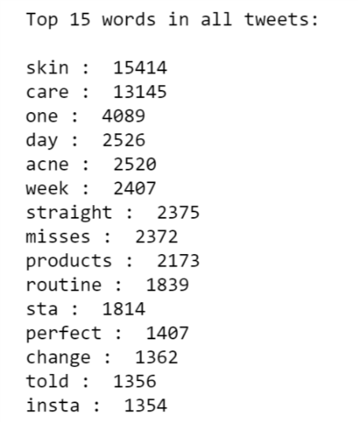

Topic 1: Skin Care
Top significant words
Top 15 popular words show in tweets
Lower case
Remove link, mentioned users (@..)
Remove punctuation
Remove stopwords

Slide 9
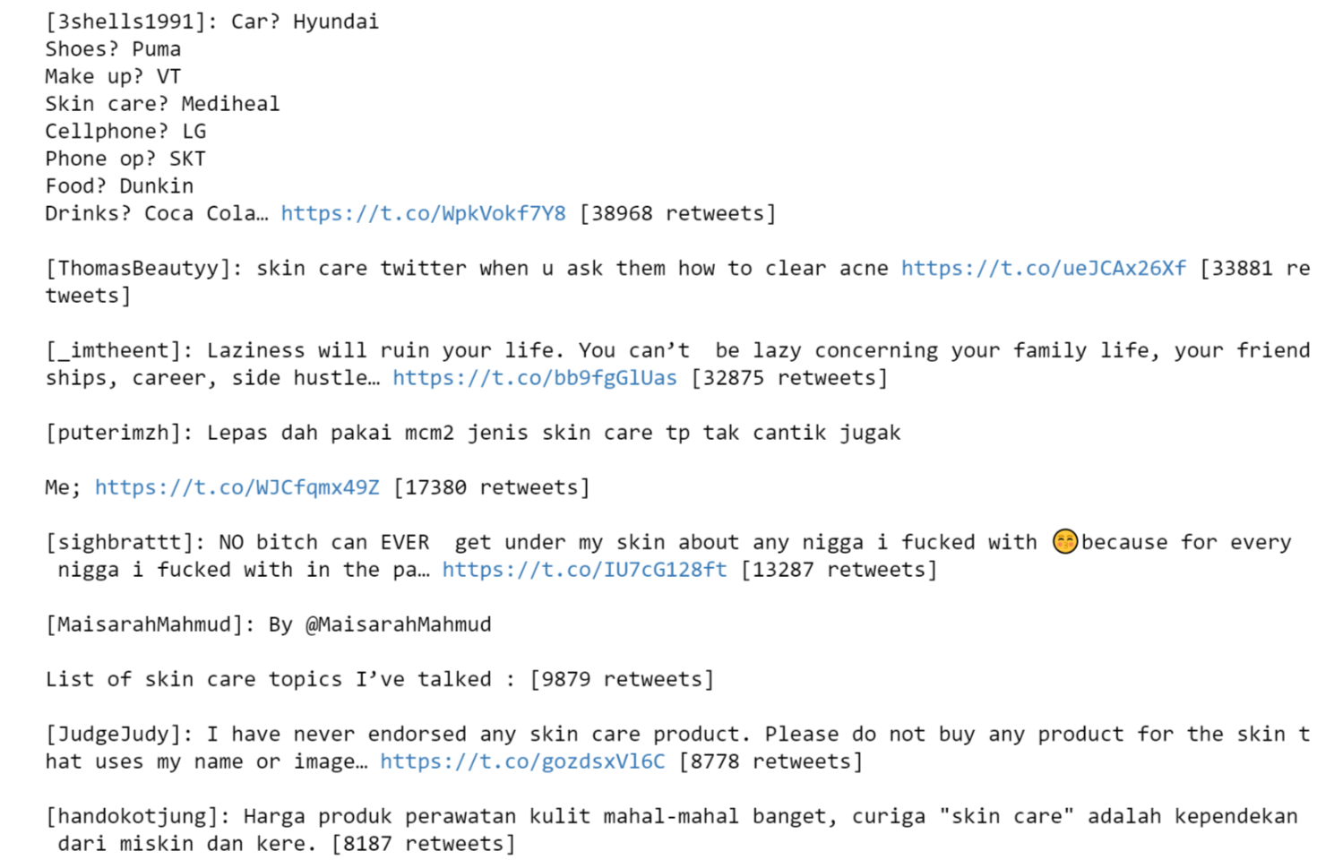
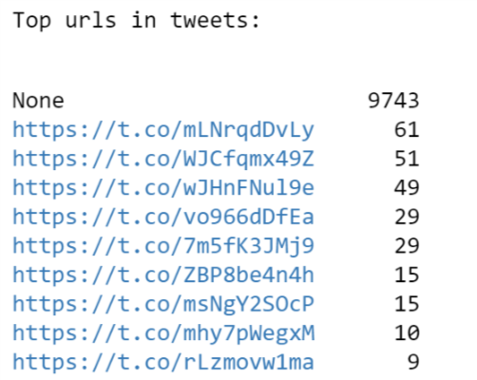
Topic 1: Skin Care
Top url
Top 10 urls in tweets
Top retweets

Slide 10

Topic 2:
Trade War
Hadoop & Data Frame

Slide 11
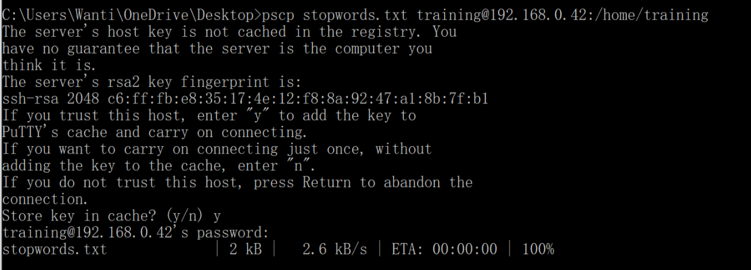
Procedure to transfer file to VM
Procedure link: https://docs.google.com/document/d/1MZ_rNxJhR4HCU1qJ2-w7xlk2MTHVqa9lnl_uj-zRkzk/pub
Use Putty to connect my computer with virtual machine
Type following code in my computer Command Prompt:

Slide 12
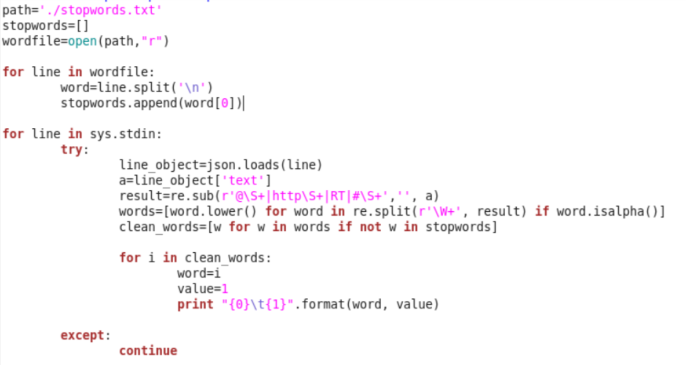
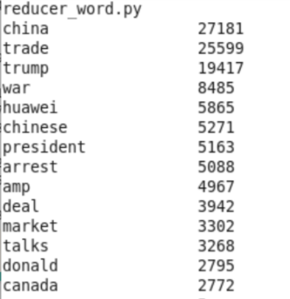
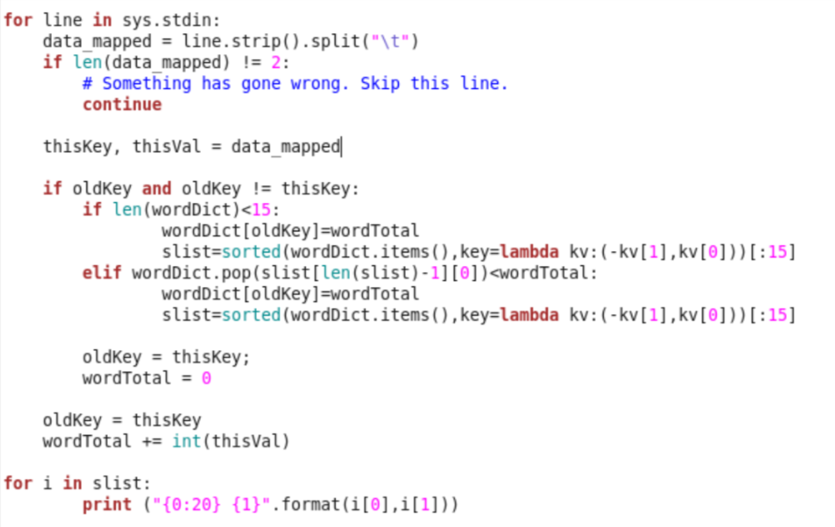
Topic 2: Trade War
Map function
Top significant words
Map:
Clean data (use stopwords.txt)
Print with format (word, 1)
Reduce: use dictionary
Reduce function

Slide 13
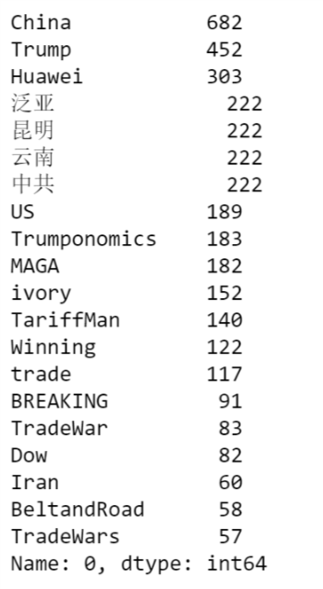
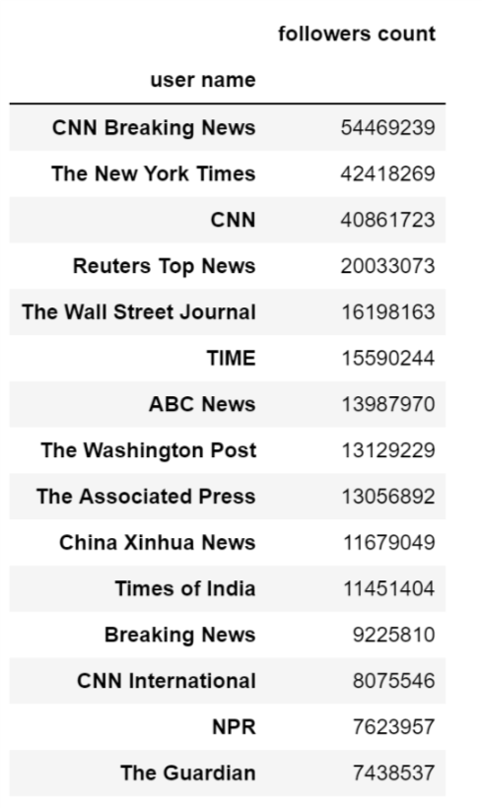
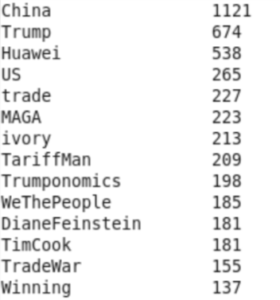
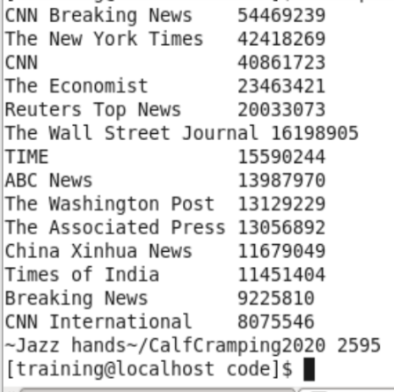
Topic 2: Trade War
Top hashtags
Numbers are little different
Top authoritative users
Users are media groups from US, China, UK, India
Data frame missed The Economist !

Slide 14
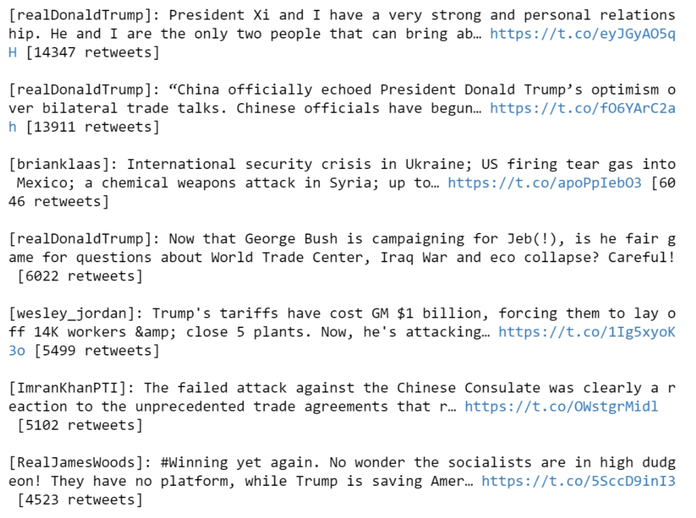
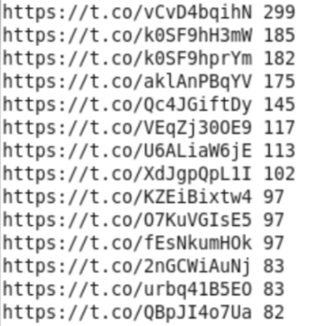
Topic 2: Trade War
Top retweets
3 of top 4 retweets are from President Trump
Top 10 urls
almost news reports related to trade war

Slide 15

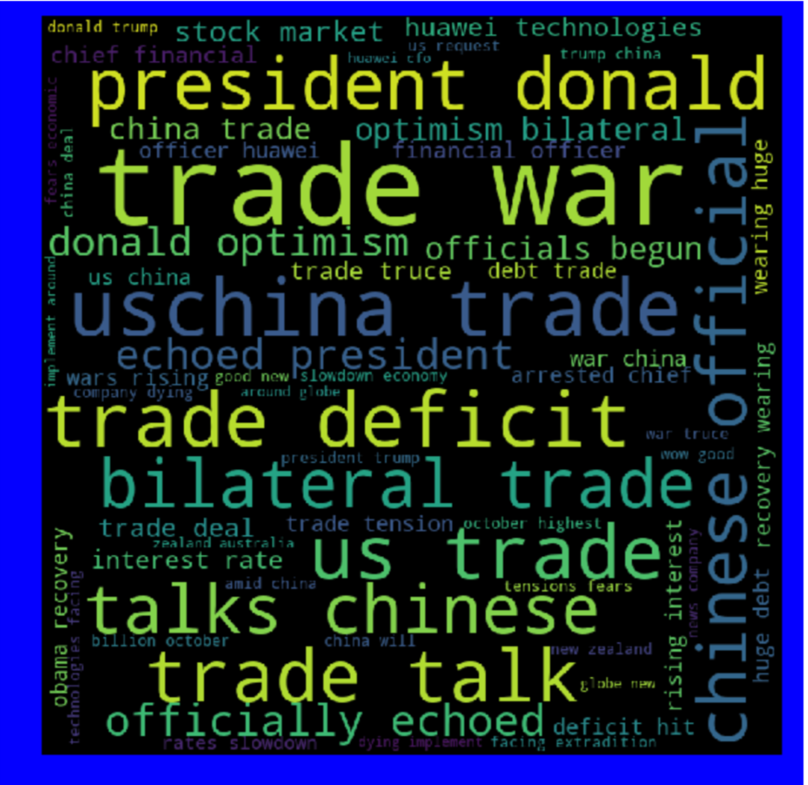
Word Cloud of Two Topics

Slide 16
Summary
Data Frame vs Hadoop
Data Frame
Interactive
Beautiful plot and tables
Easy to implement (lots of packages to use)
Can read multiple languages
Hadoop
Can deal with big data
Result is more accurate

Slide 17
Q&A

